Slide 1
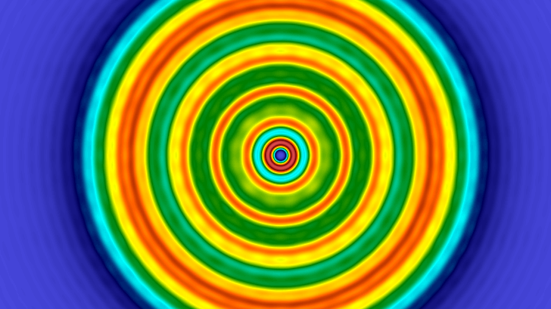
Fresnel diffraction integral using sinc approximation
By: Teddy Meissner
Advised By: Moysey Brio

Slide 2
Overview
Motivation
What is Diffraction/Fresnel Diffraction?
Solving the Helmholtz paraxial wave equation
Computing the solution
FFT – and why/when it is inaccurate
Sinc method – and how it solves FFT’s issues
Examples and visuals of two sources
Gaussian Initial condition
Circular Aperture Initial condition
Sinc vs. FFT comparison plots
For fixed length (z – propagates)
For fixed step size (z – propagates)
Convergence analysis and CPU times
Future work (possible)

Slide 3
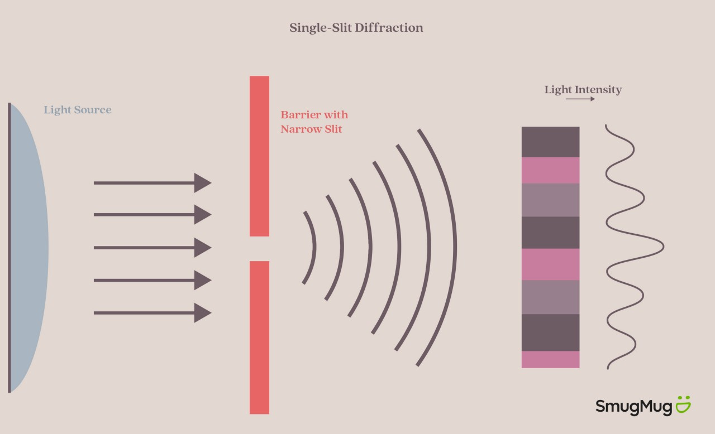
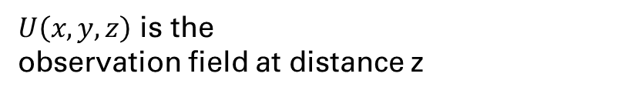
What is diffraction?
Diffraction - the process by which a beam of light or other system of waves is spread out as a result of passing through a narrow aperture or across an edge
𝑢(𝑥,𝑦,z=0)- Initial condition
$U\left(x,y,z\right)$ is the
observation field at distance z

Slide 4
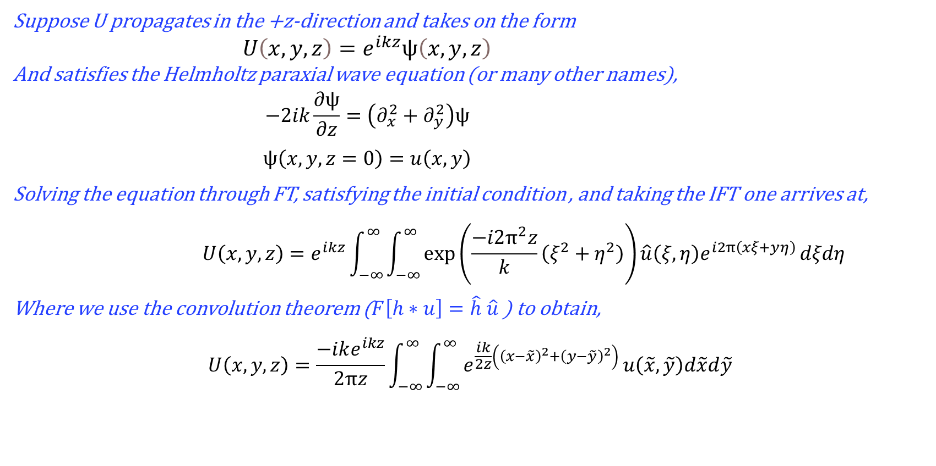
Solution to the Helmholtz paraxial wave equation
Suppose U propagates in the +z-direction and takes on the form
$$U\left(x,y,z\right)=e^{ikz}ψ\left(x,y,z\right)$$
And satisfies the Helmholtz paraxial wave equation (or many other names),
$$−2ik\frac{∂ψ}{∂z}=\left(∂_{x}^{2}+∂_{y}^{2}\right)ψ$$
$$ψ\left(x,y,z=0\right)=u\left(x,y\right)$$
Solving the equation through FT, satisfying the initial condition , and taking the IFT one arrives at,
$$U\left(x,y,z\right)=e^{ikz}\int_{−∞}^{∞}{\int_{−∞}^{∞}{\exp\left(\frac{−i2π^{2}z}{k}\left(ξ^{2}+η^{2}\right)\right)\hat{u}\left(ξ,η\right)e^{i2π\left(xξ+yη\right)}}}dξdη$$
Where we use the convolution theorem ($F\left[h∗u\right]=\hat{h} \hat{u}$) to obtain,
$$U\left(x,y,z\right)=\frac{−ike^{ikz}}{2πz}\int_{−∞}^{∞}{\int_{−∞}^{∞}{e^{\frac{ik}{2z}\left({\left(x−\tilde{x}\right)}^{2}+{\left(y−\tilde{y}\right)}^{2}\right)}}}u\left(\tilde{x},\tilde{y}\right)d\tilde{x}d\tilde{y}$$
For full derivation see: Pritchett, Timothy. (2004). Spectral Solution of the Helmholtz and Paraxial Wave Equations and Classical Diffraction Formulae. 28.

Slide 5
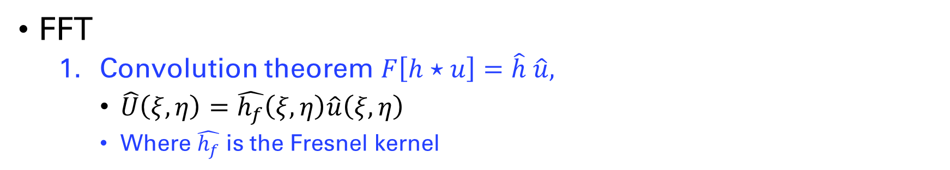
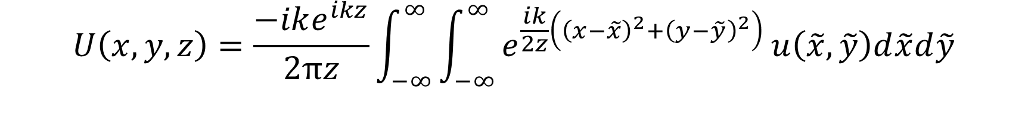
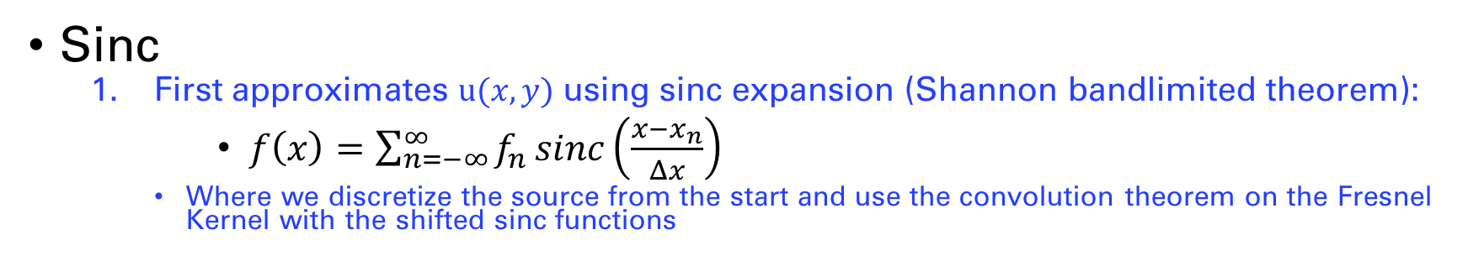
$$U\left(x,y,z\right)=\frac{−ike^{ikz}}{2πz}\int_{−∞}^{∞}{\int_{−∞}^{∞}{e^{\frac{ik}{2z}\left({\left(x−\tilde{x}\right)}^{2}+{\left(y−\tilde{y}\right)}^{2}\right)}}}u\left(\tilde{x},\tilde{y}\right)d\tilde{x}d\tilde{y}$$
Computing the solution
FFT
Convolution theorem $F\left[h⋆u\right]=\hat{h} \hat{u},$
$\hat{U}\left(ξ,η\right)=\hat{h_{f}}\left(ξ,η\right)\hat{u}\left(ξ,η\right)$
Where $\hat{h_{f}}$ is the Fresnel kernel
Sinc
First approximates $u(x,y)$ using sinc expansion (Shannon bandlimited theorem):
$f\left(x\right)=\sum_{n=−∞}^{∞}{f_{n }sinc\left(\frac{x−x_{n}}{Δx}\right)}$
Where we discretize the source from the start and use the convolution theorem on the Fresnel Kernel with the shifted sinc functions

Slide 6
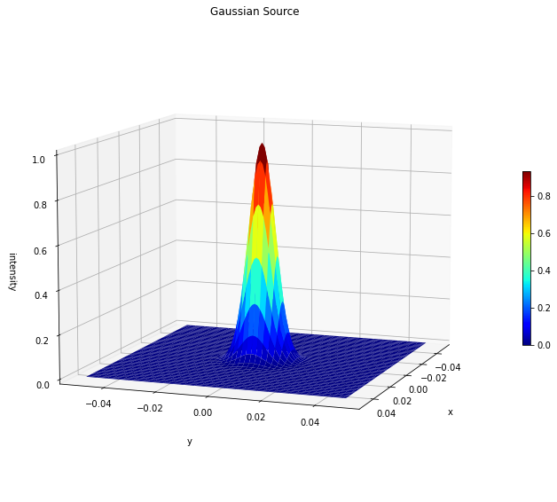
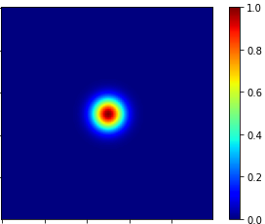
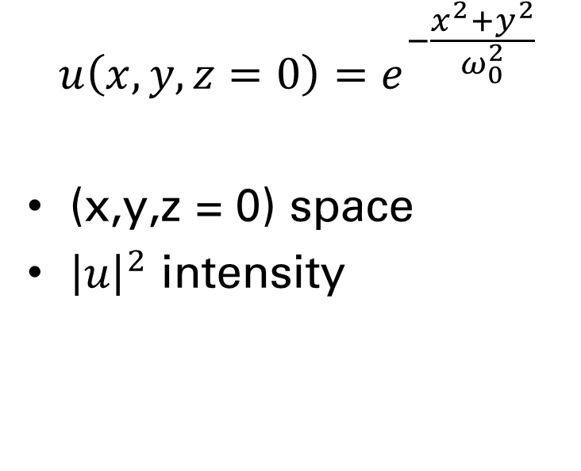
Gaussian initial data
$$u\left(x,y,z=0\right)=e^{−\frac{x^{2}+y^{2}}{ω_{0}^{2}}}$$
(x,y,z = 0) space
${\left|u\right|}^{2}$ intensity

Slide 7
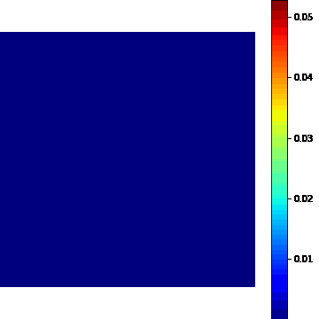
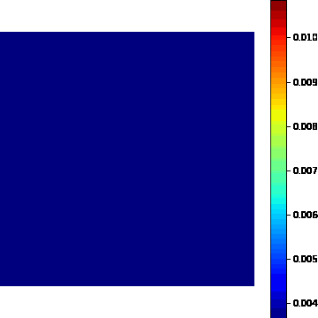
Solution for gaussian initial data
FFT
Sinc

Slide 8
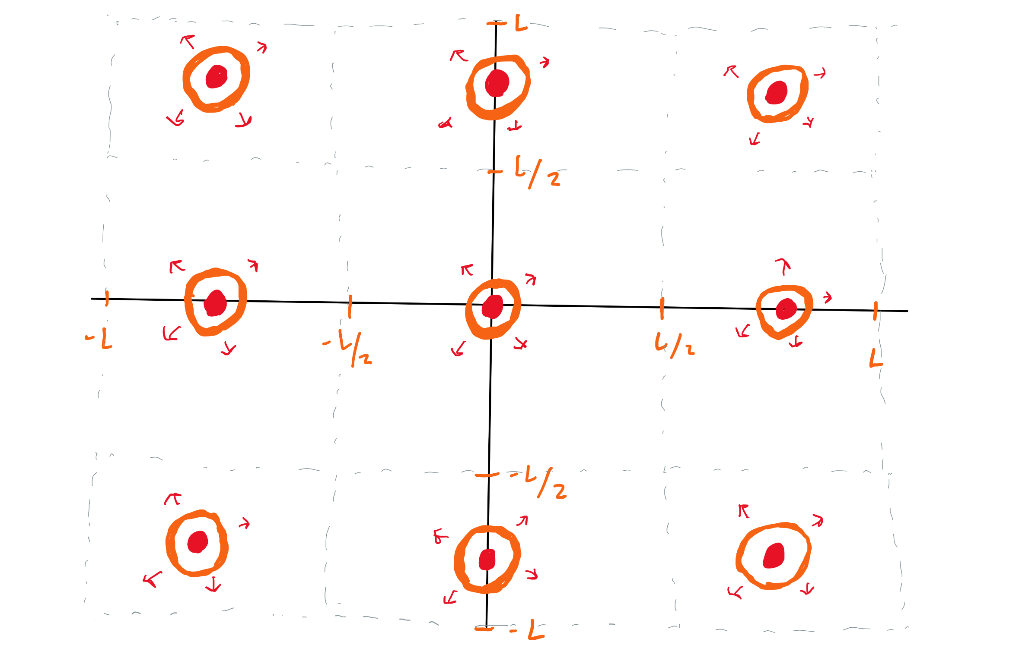
Fourier Transform
When we truncate the initial condition, we are assuming periodic boundary conditions.
The way to solve this issue is to increase the size of the domain which can be computationally expensive

Slide 9
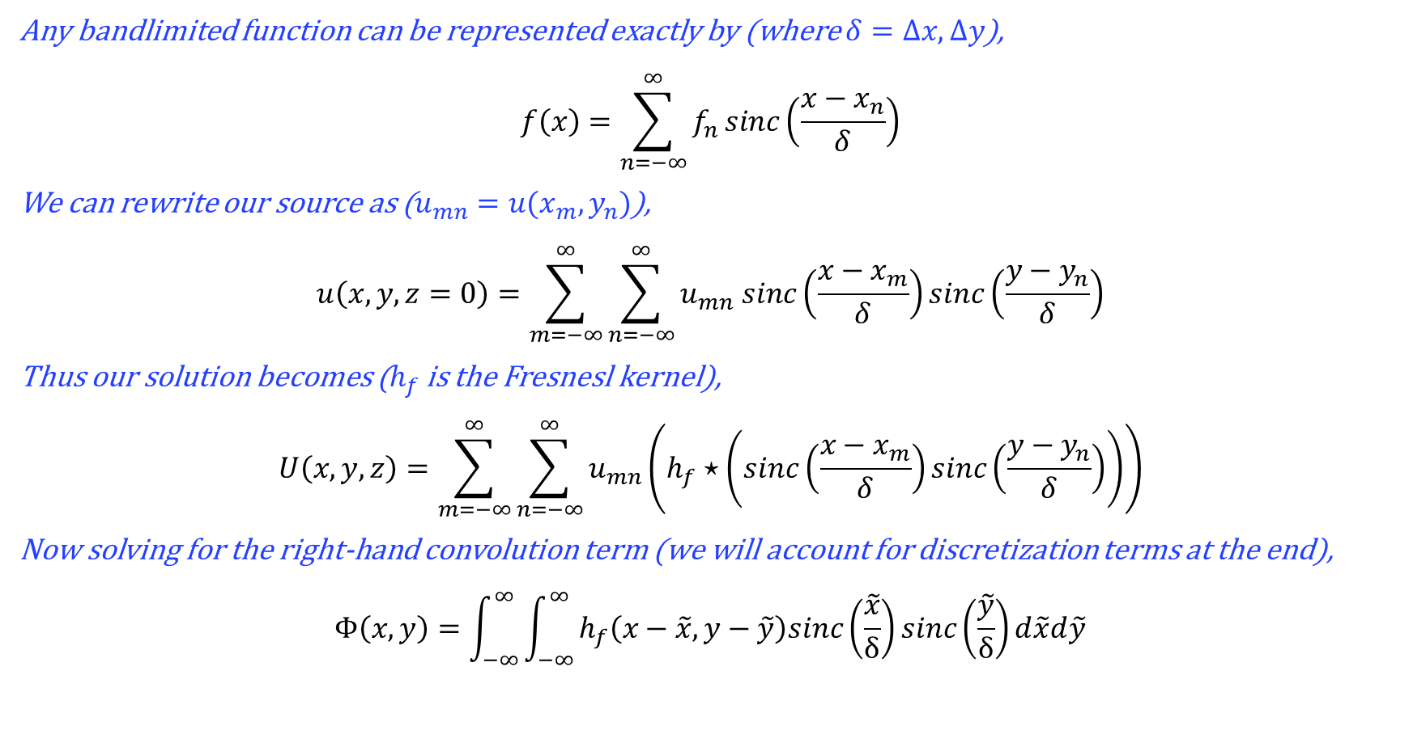
Sinc Solution
Any bandlimited function can be represented exactly by (where $δ=Δx, Δy$),
$$f\left(x\right)=\sum_{n=−∞}^{∞}{f_{n }sinc\left(\frac{x−x_{n}}{δ}\right)}$$
We can rewrite our source as ($u_{mn}=u(x_{m},y_{n})$),
$$u\left(x,y,z=0\right)=\sum_{m=−∞}^{∞}{\sum_{n=−∞}^{∞}{u_{mn} sinc\left(\frac{x−x_{m}}{δ}\right)sinc\left(\frac{y−y_{n}}{δ}\right)}}$$
Thus our solution becomes ($h_{f}$ is the Fresnesl kernel),
$$U\left(x,y,z\right)=\sum_{m=−∞}^{∞}{\sum_{n=−∞}^{∞}{u_{mn}\left(h_{f}⋆\left(sinc\left(\frac{x−x_{m}}{δ}\right)sinc\left(\frac{y−y_{n}}{δ}\right)\right)\right)}}$$
Now solving for the right-hand convolution term (we will account for discretization terms at the end),
$$Φ\left(x,y\right)=\int_{−∞}^{∞}{\int_{−∞}^{∞}{h_{f}\left(x−\tilde{x},y−\tilde{y}\right)sinc\left(\frac{\tilde{x}}{δ}\right)sinc\left(\frac{\tilde{y}}{δ}\right)d\tilde{x}d\tilde{y}}}$$

Slide 10
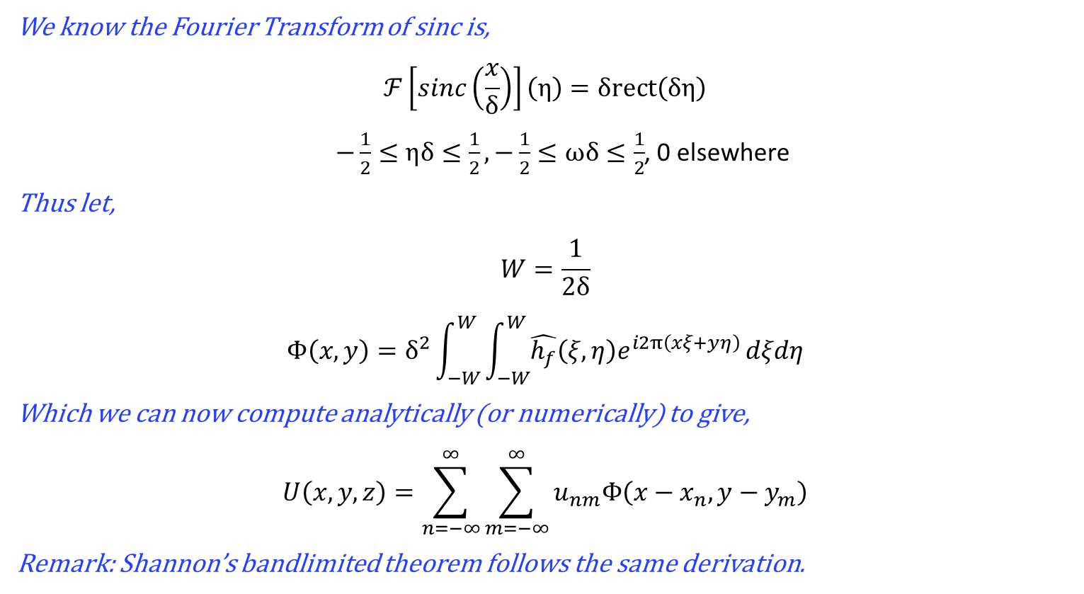
Sinc Solution cont.
We know the Fourier Transform of sinc is,
$$ℱ\left[sinc\left(\frac{x}{δ}\right)\right]\left(η\right)=δrect\left(δη\right)$$
$−\frac{1}{2}≤ηδ≤\frac{1}{2},−\frac{1}{2}≤ωδ≤\frac{1}{2}$, 0 elsewhere
Thus let,
$$W=\frac{1}{2δ}$$
$$Φ\left(x,y\right)=δ^{2}\int_{−W}^{W}{\int_{−W}^{W}{\hat{h_{f}}\left(ξ,η\right)e^{i2π\left(xξ+yη\right)}}}dξdη$$
Which we can now compute analytically (or numerically) to give,
$$U\left(x,y,z\right)=\sum_{n=−∞}^{∞}{\sum_{m=−∞}^{∞}{u_{nm}Φ\left(x−x_{n},y−y_{m}\right)}}$$
Remark: Shannon’s bandlimited theorem follows the same derivation.

Slide 11
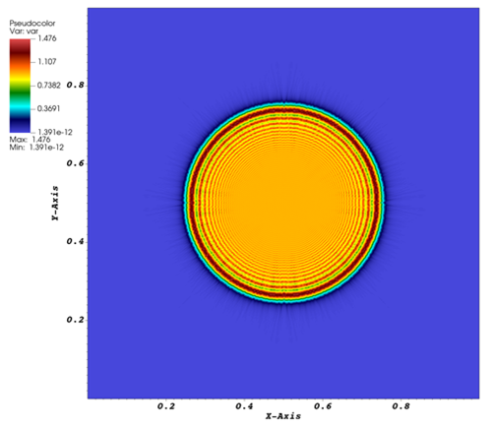

Circular Aperture Initial Condition
$$u\left(x,y,z_{0}\right)=\frac{Acirc\left(\frac{r}{r_{0}}\right)\left(e^{ik\sqrt{{\left(x−x_{0}\right)}^{2}+{\left(y−y_{0}\right)}^{2}+z_{0}^{2}}}\right)}{{\left(x−x_{0}\right)}^{2}+{\left(y−y_{0}\right)}^{2}+z_{0}^{2}\text{)}}$$

Slide 12
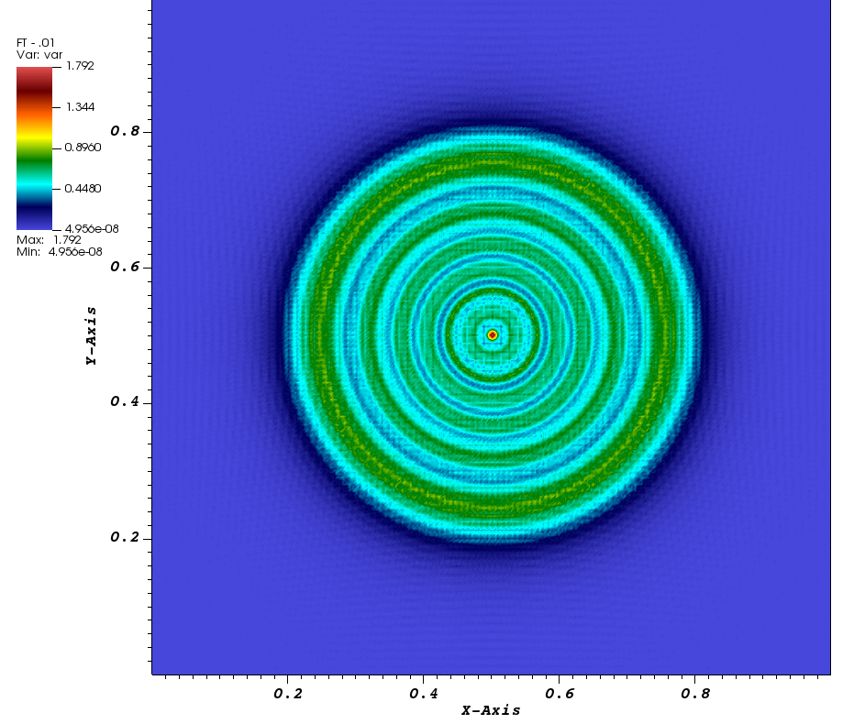
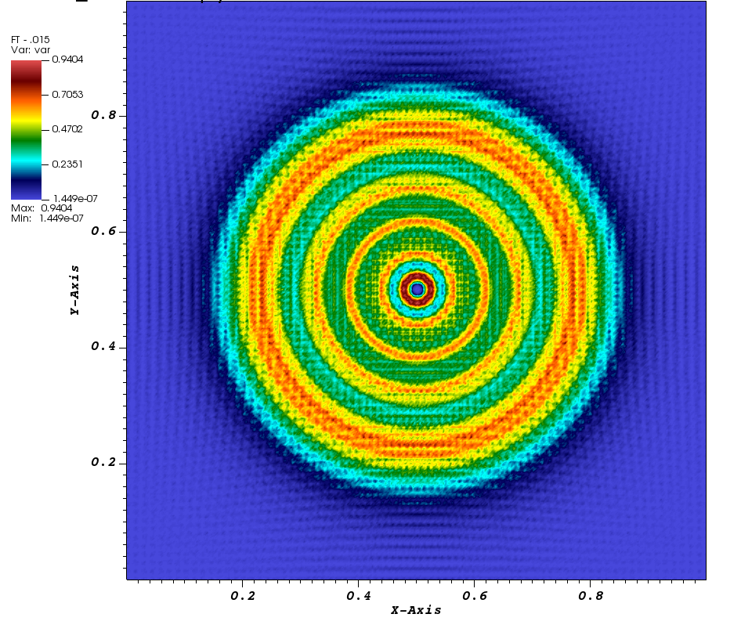
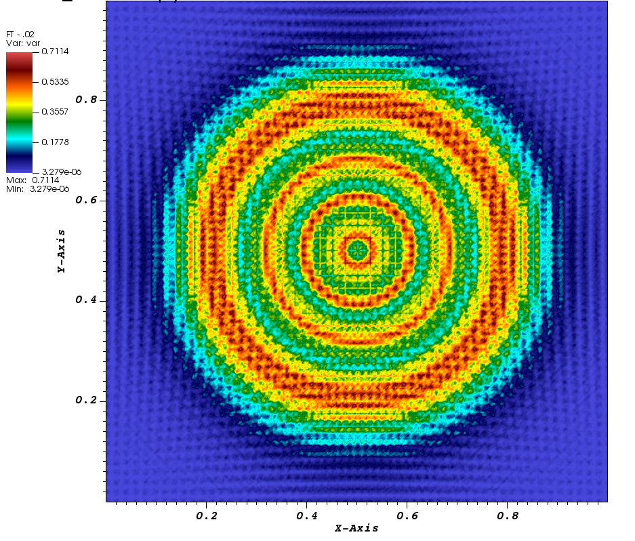
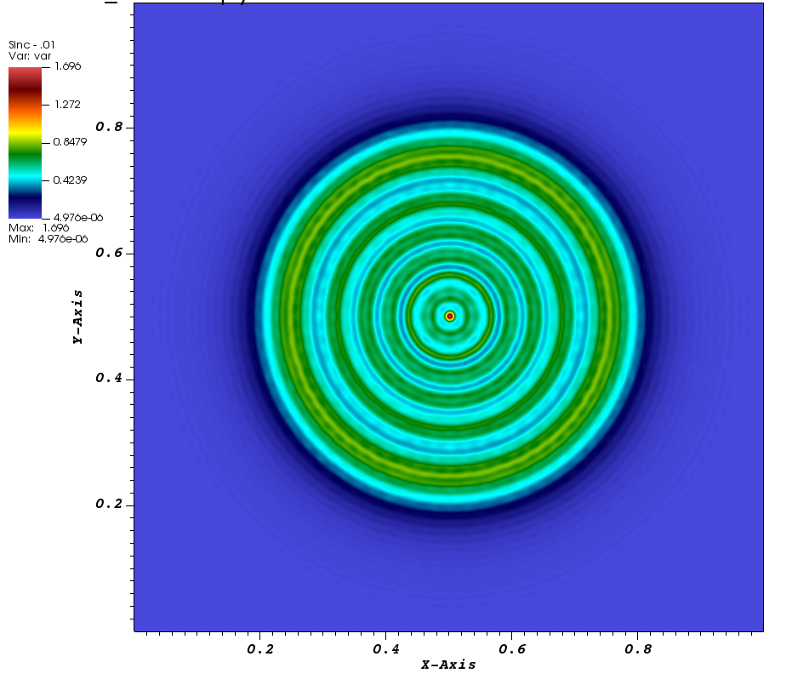
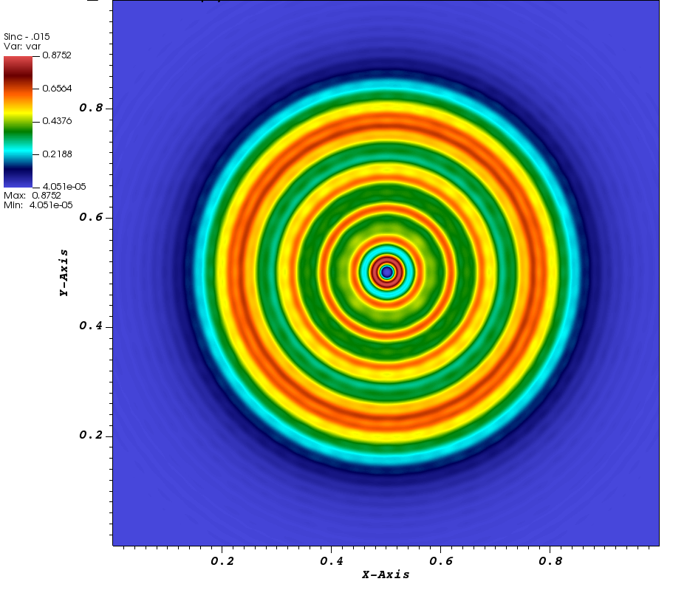
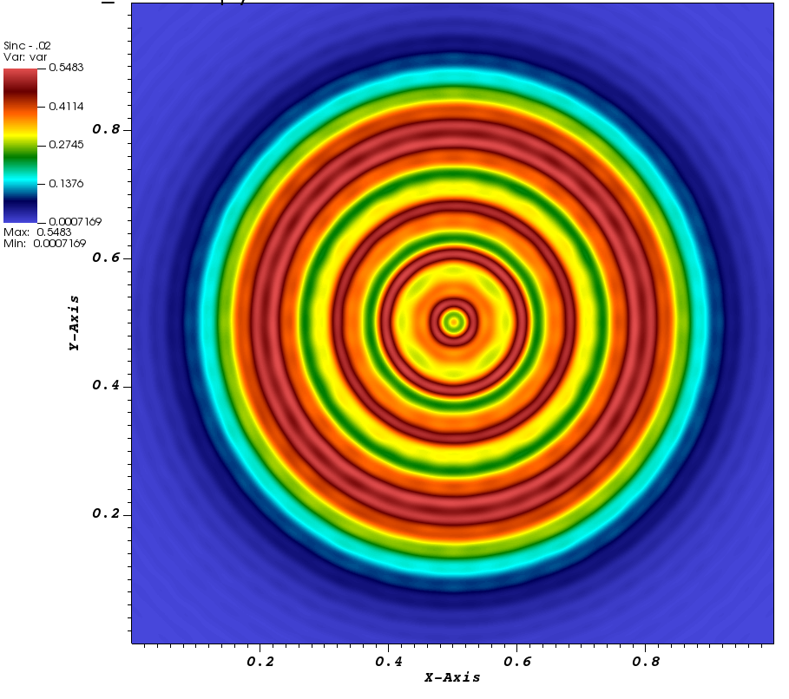
Solution for Circular Aperture
Z = .010
Z = .015
Z = .02
FFT
FFT
Sinc

Slide 13
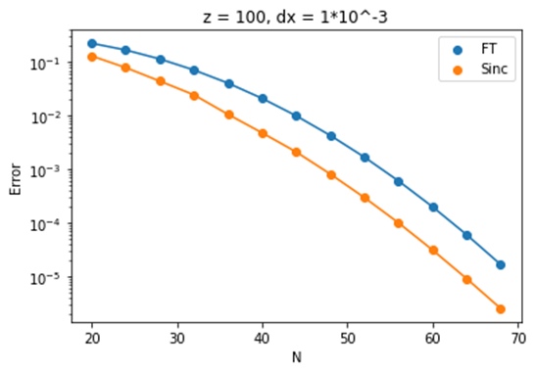
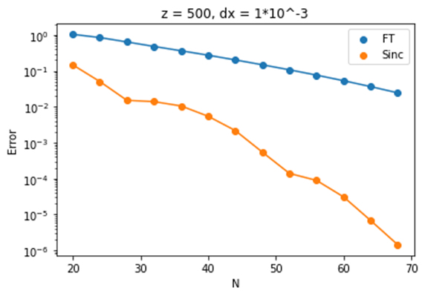
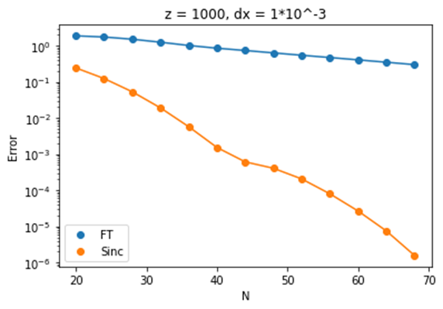
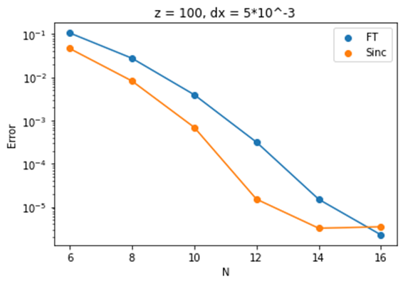
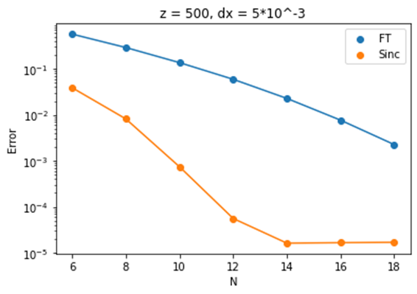
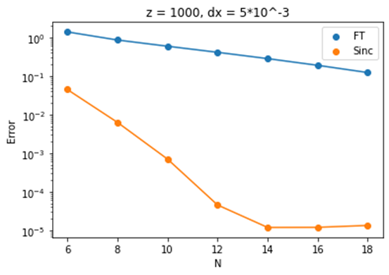
Sinc vs FFT gaussian error for fixed dx = .001, .005

Slide 14
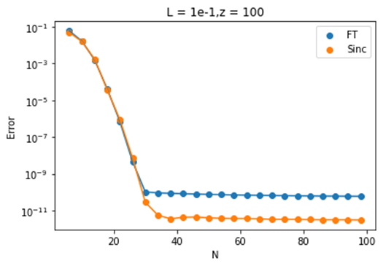
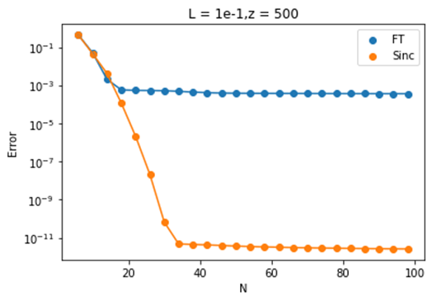
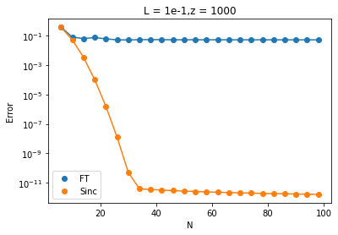
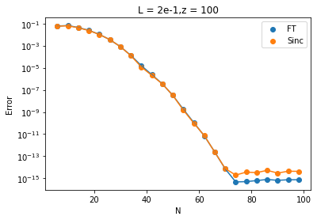
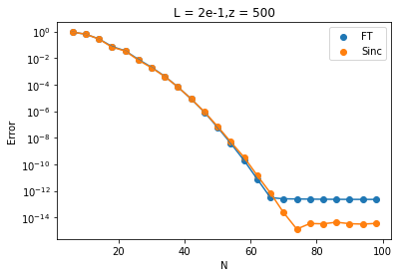
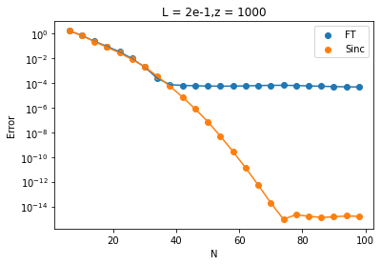
Sinc vs FFT gaussian error for fixed L = .1, .2

Slide 15
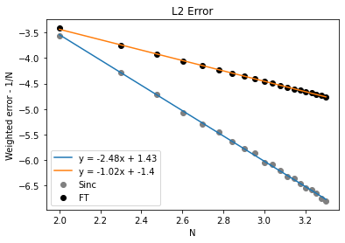
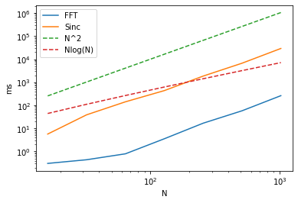
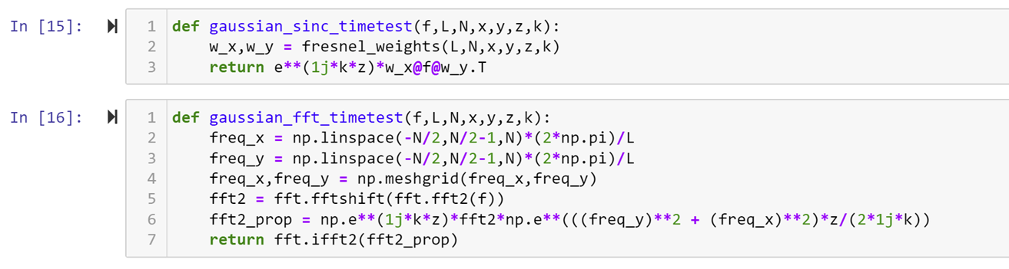
Sinc vs FFT convergence rates for the circular aperture
CPU times

Slide 16
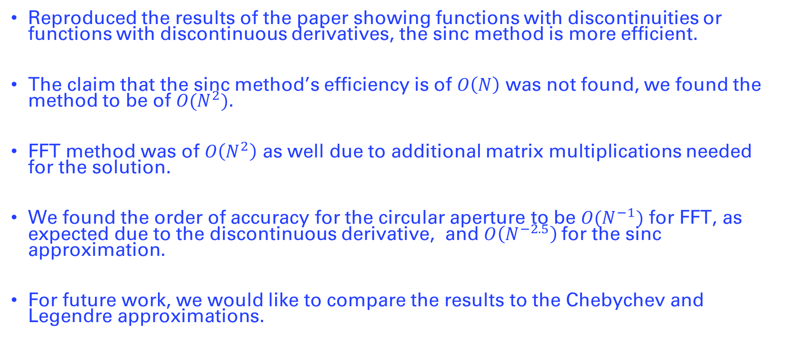
Conclusion
Reproduced the results of the paper showing functions with discontinuities or functions with discontinuous derivatives, the sinc method is more efficient.
The claim that the sinc method’s efficiency is of $O\left(N\right)$ was not found, we found the method to be of $O(N^{2})$.
FFT method was of $O\left(N^{2}\right)$ as well due to additional matrix multiplications needed for the solution.
We found the order of accuracy for the circular aperture to be $O(N^{−1})$ for FFT, as expected due to the discontinuous derivative, and $O\left(N^{−2.5}\right)$for the sinc approximation.
For future work, we would like to compare the results to the Chebychev and Legendre approximations.

Slide 17
References
Max Cubillos, Edwin Jimenez, Diffraction integral computation using sinc approximation, Applied Numerical Mathematics,Volume 178,2022,Pages 69-83, ISSN 0168-9274,https://doi.org/10.1016/j.apnum.2022.02.011.
J. A. C. Weideman and S. C. Reddy, A MATLAB differentiation matrix suite, ACM Trans. Math. Softw. 26 (2000), 465–519. [A widely-used collection of Matlab programs for generating Chebyshev, Legendre, Laguerre, Hermite, Fourier, and sinc spectral differentiation matrices of arbitrary order.]
F. Stenger, Numerical Methods Based on Sinc and Analytic Functions, Springer, 1993. [Comprehensive treatise by the leader in sinc function algorithms.]
F. Stenger, Sinc Numerical Methods, CRC Press, 2011. [A handbook of sinc methods and their implementation by the author’s software package Sinc-Pack.]

